Slide 1
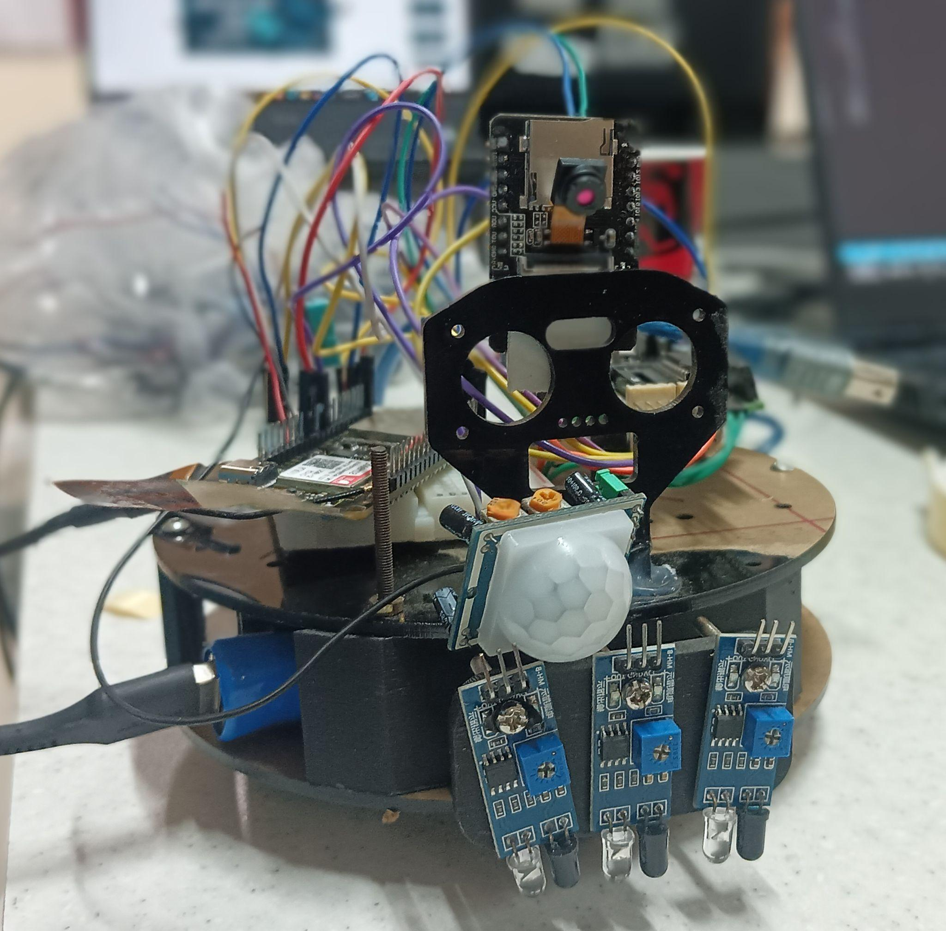



Night Patrol Robot
Presented by:
Raj Nipun Singh
Devesh Kumar
Vishesh Jawa
Course : ECE360 IOT
Instructor : Dr. Rohit Singh

Slide 2
Table of Content
Abstract
Objective
Introduction
Hardware components
Software & Communication
Data Flow
Features in Action
Code
Results

Slide 3
Abstract
The Night Patrol Robot project involves designing and building a robot that can monitor a specific area or location during the night.
We ideated on a bunch of methods to achieve the objective but we settled on using the arduino to control the motors and ESP32 to get the sensor data as it was the most efficient way to do things .
We believe that the night patrol robot can be integrated into the daily lives of people and has more potential than to just be used as a surveillance tool

Slide 4



Objective
To design and build a mobile robot capable of autonomous patrolling.
To implement real-time environmental monitoring (temperature, humidity).
To detect motion.
To stream data and alerts to users via a web interface and mobile app.

Slide 5
Introduction
Our night patrol robot is a standalone security device that can be used in places where we need extra security in conjunction with surveillance CCTV and the likes or in places where there has to be a discrete security system which can’t be seen by the people being observed
(example places with high crime rate where cctv are destroyed)
•Arduino Uno R3 with Motor Driver: Controls motors | •ESP32: Manages sensors, Bluetooth, and Wi-Fi communication.
•HC-05 Bluetooth: For app control | •Web UI (HTML/JS): Live monitoring dashboard.

Slide 6
Hardware Components
ESP32 Dev Module – Wi-Fi, sensor interface
Arduino Uno R3 – Motor driver interface
HC-SR501 PIR Sensor – Motion detection
DHT11 Sensor – Temperature & humidity
HC-05 Module – Bluetooth control
Rechargeable Battery
ESP32 Camera

Slide 7
Software & Communication
Arduino IDE – ESP32 and Arduino programming
HTML+CSS + JavaScript – Real-time web interface
Bluetooth & Wi-Fi – Dual-mode communication

Slide 8
Data Flow
HC05 Bluetooth Module
Arduino Uno R3 + Motor Driver
Motors + ESP32 Cam
The bluetooth module connects to the phone app and sends data to the arduino
The Arduino Uno receives data from the Bluetooth module and process it to give commands to the motors
The motors and ESP32 Cam are connected to the arduino and get power supply through it and the motors also receive commands from the arduino to move

Slide 9
Data Flow
DH11 and PIR sensor
ESP32 Microcontroller
Web App Dashboard
The DH11 and PIR sensors are connected to the ESP32 microcontroller and sends data to it
The ESP32 microcontroller receives the data from the sensors and publishes it to the MQTT broker over Wifi
The web app subscribes to the MQTT topic and shows the data published by the sensors and also the ESP32 Cam camera feed

Slide 10
Features in Action
Real-time environment data
Live motion alerts (PIR)
Remote robot control by app
Voice robot control by app
Live Camera Feed
Web Dashboard (via Wi-Fi)
Mobile app (via Bluetooth)

Slide 11
CODE

Slide 12
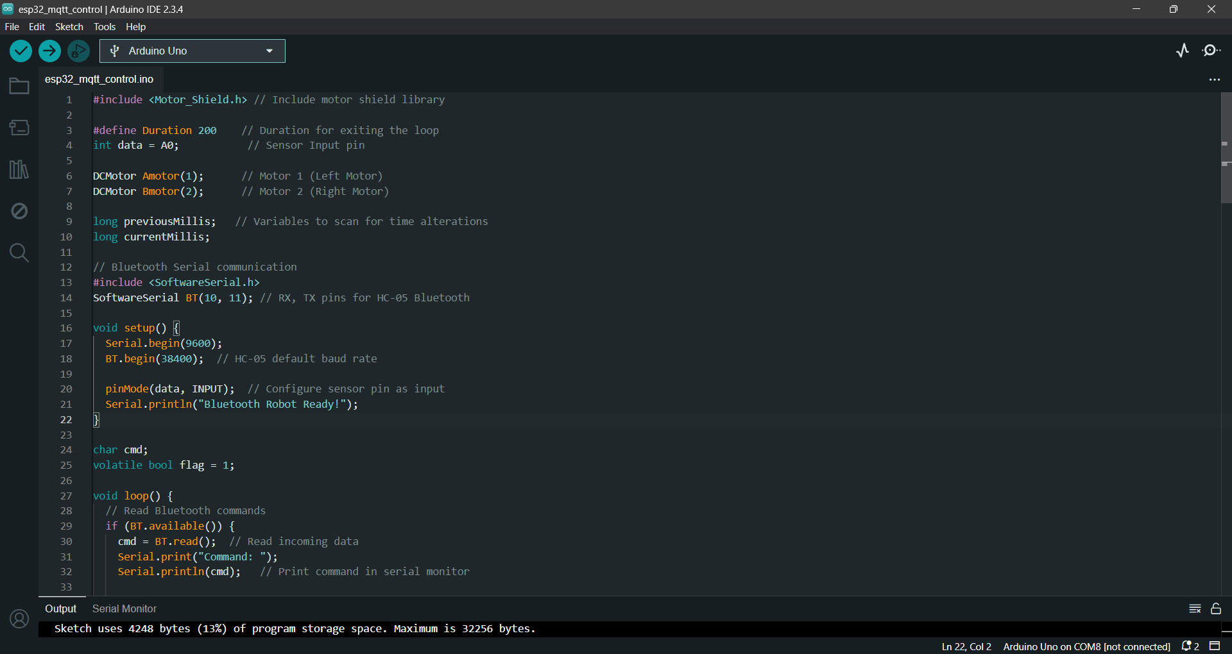

Slide 13
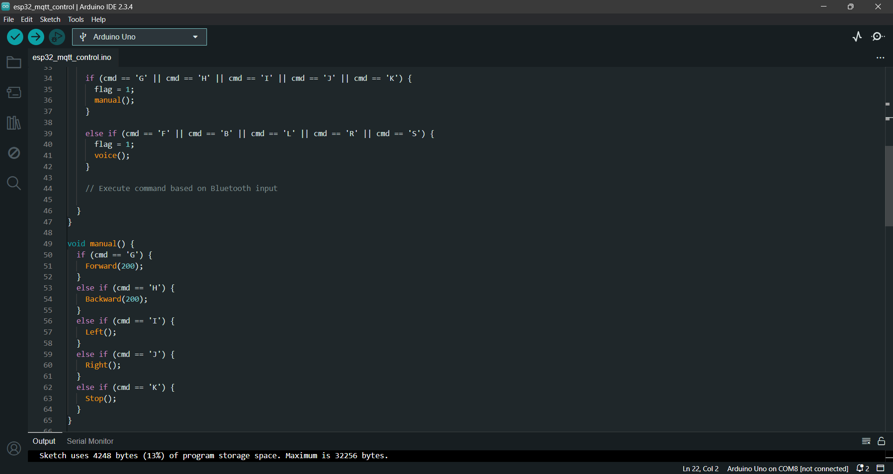

Slide 14
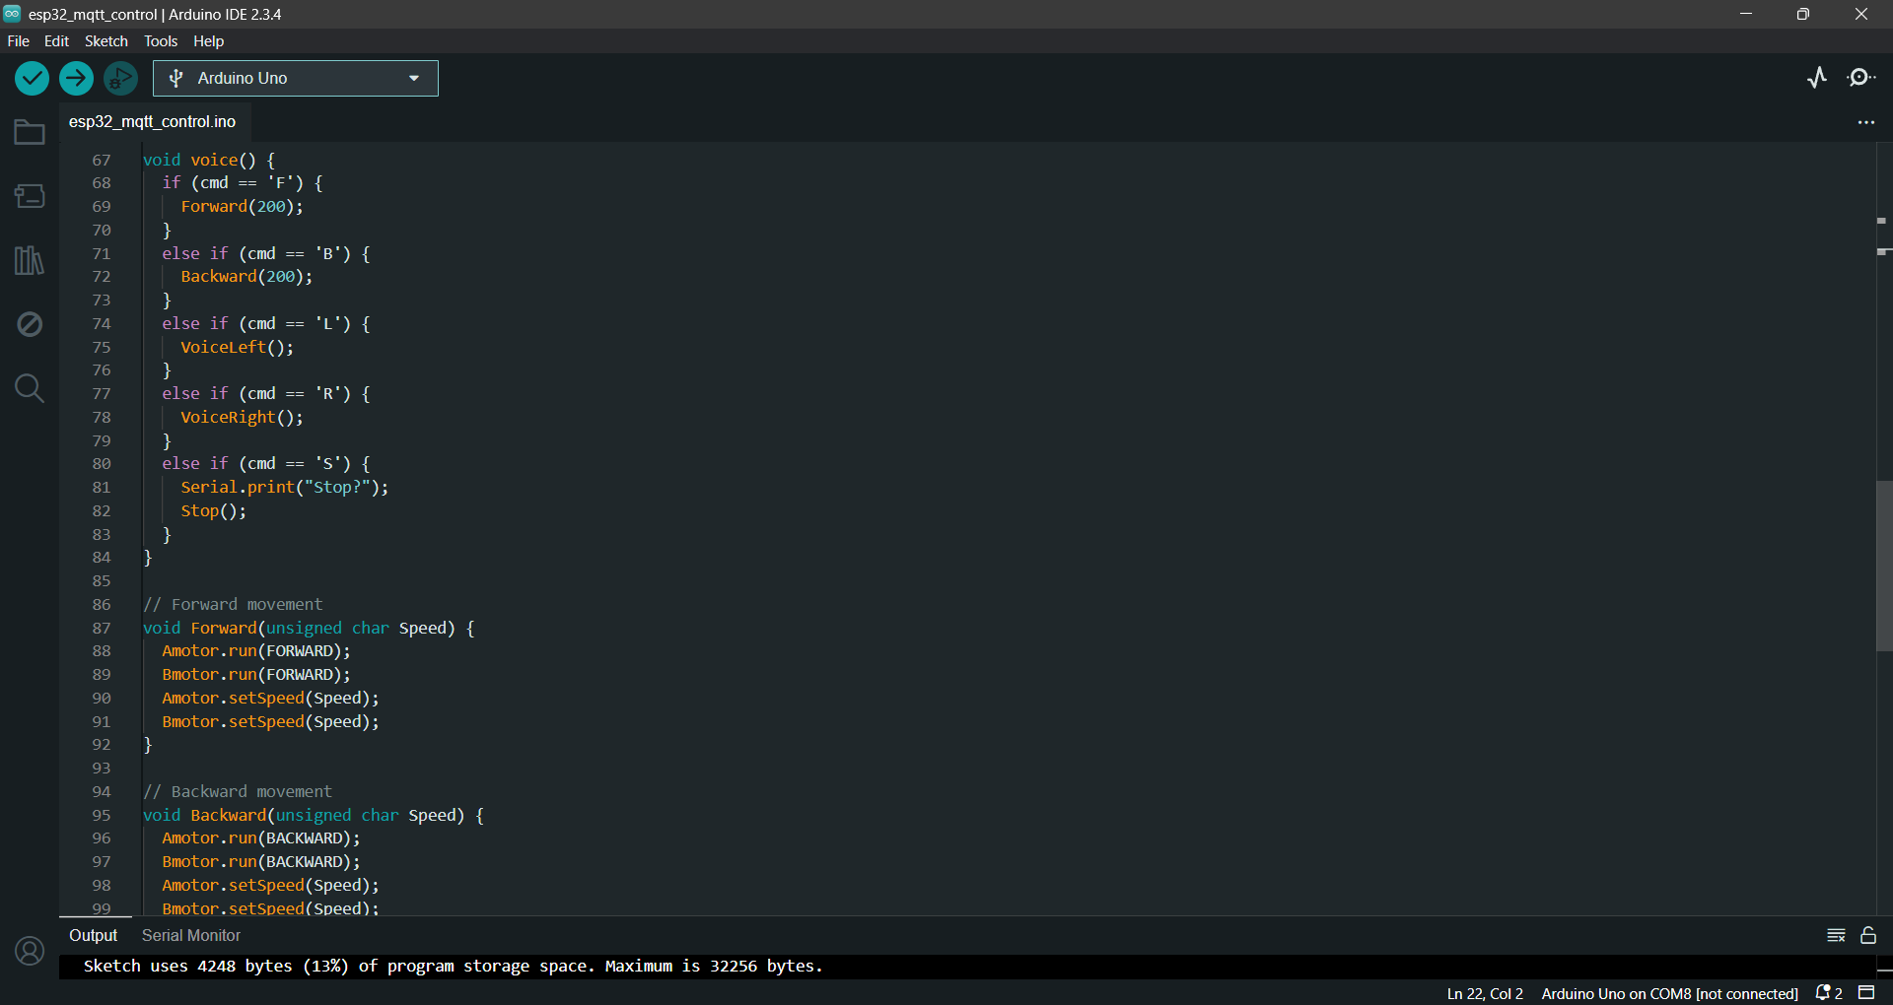

Slide 15
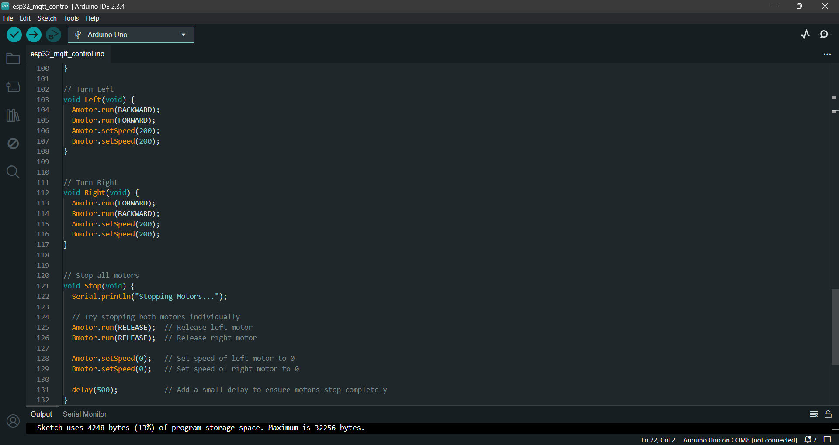

Slide 16
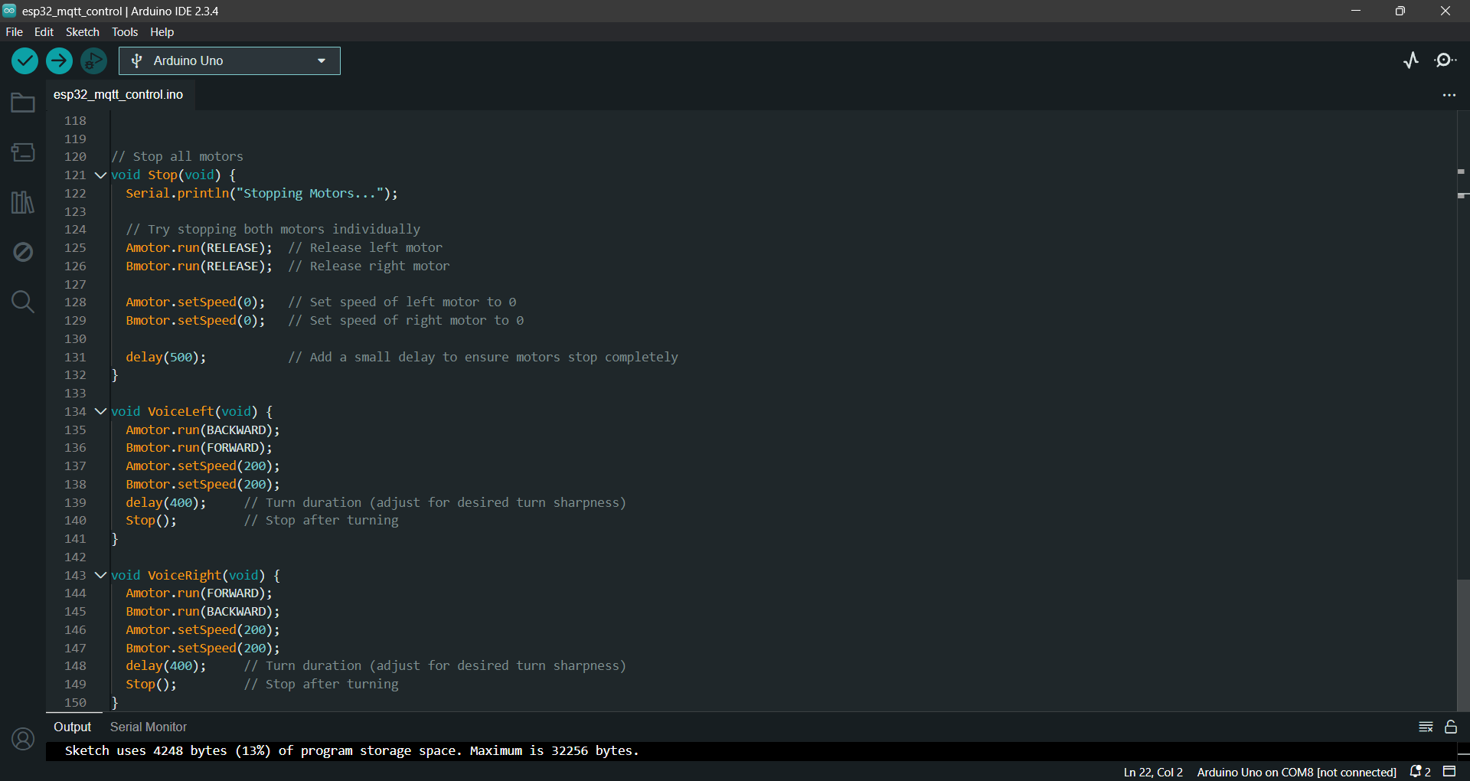

Slide 17
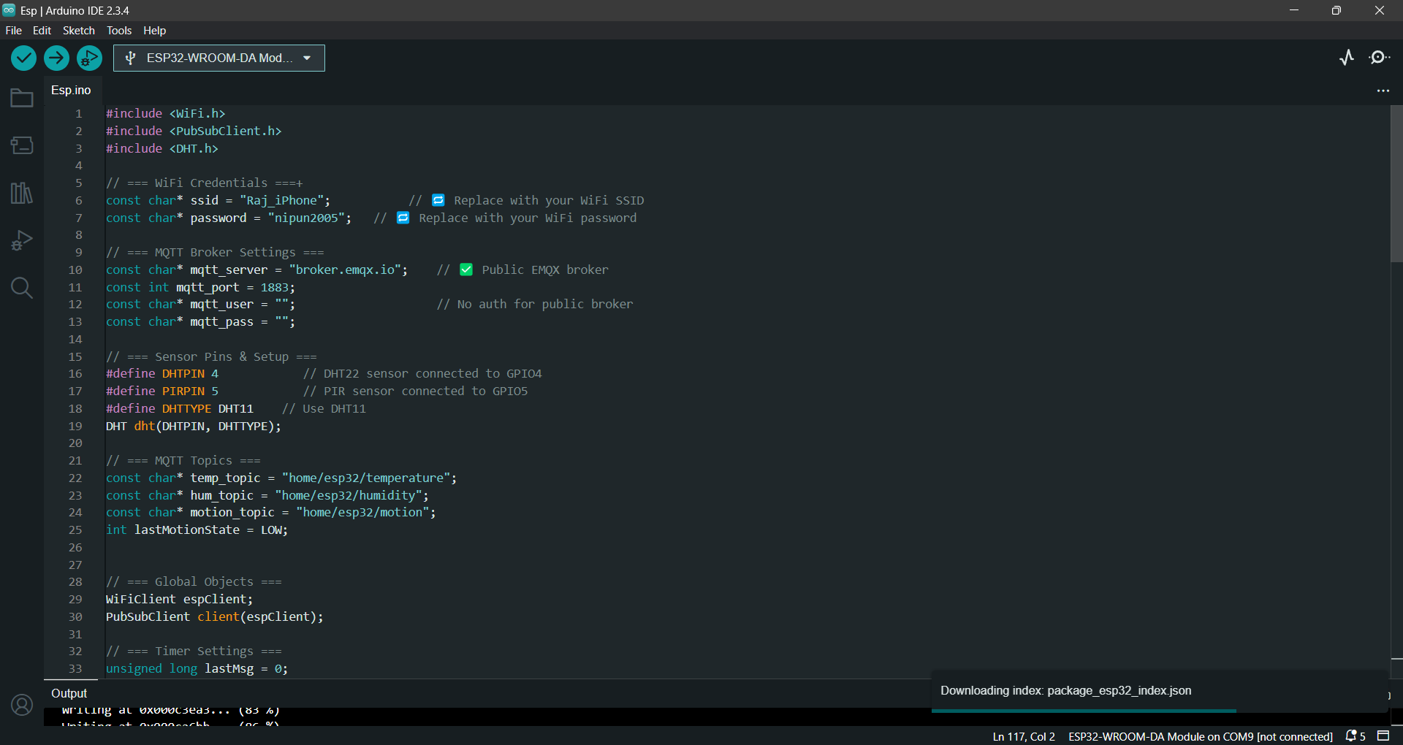

Slide 18
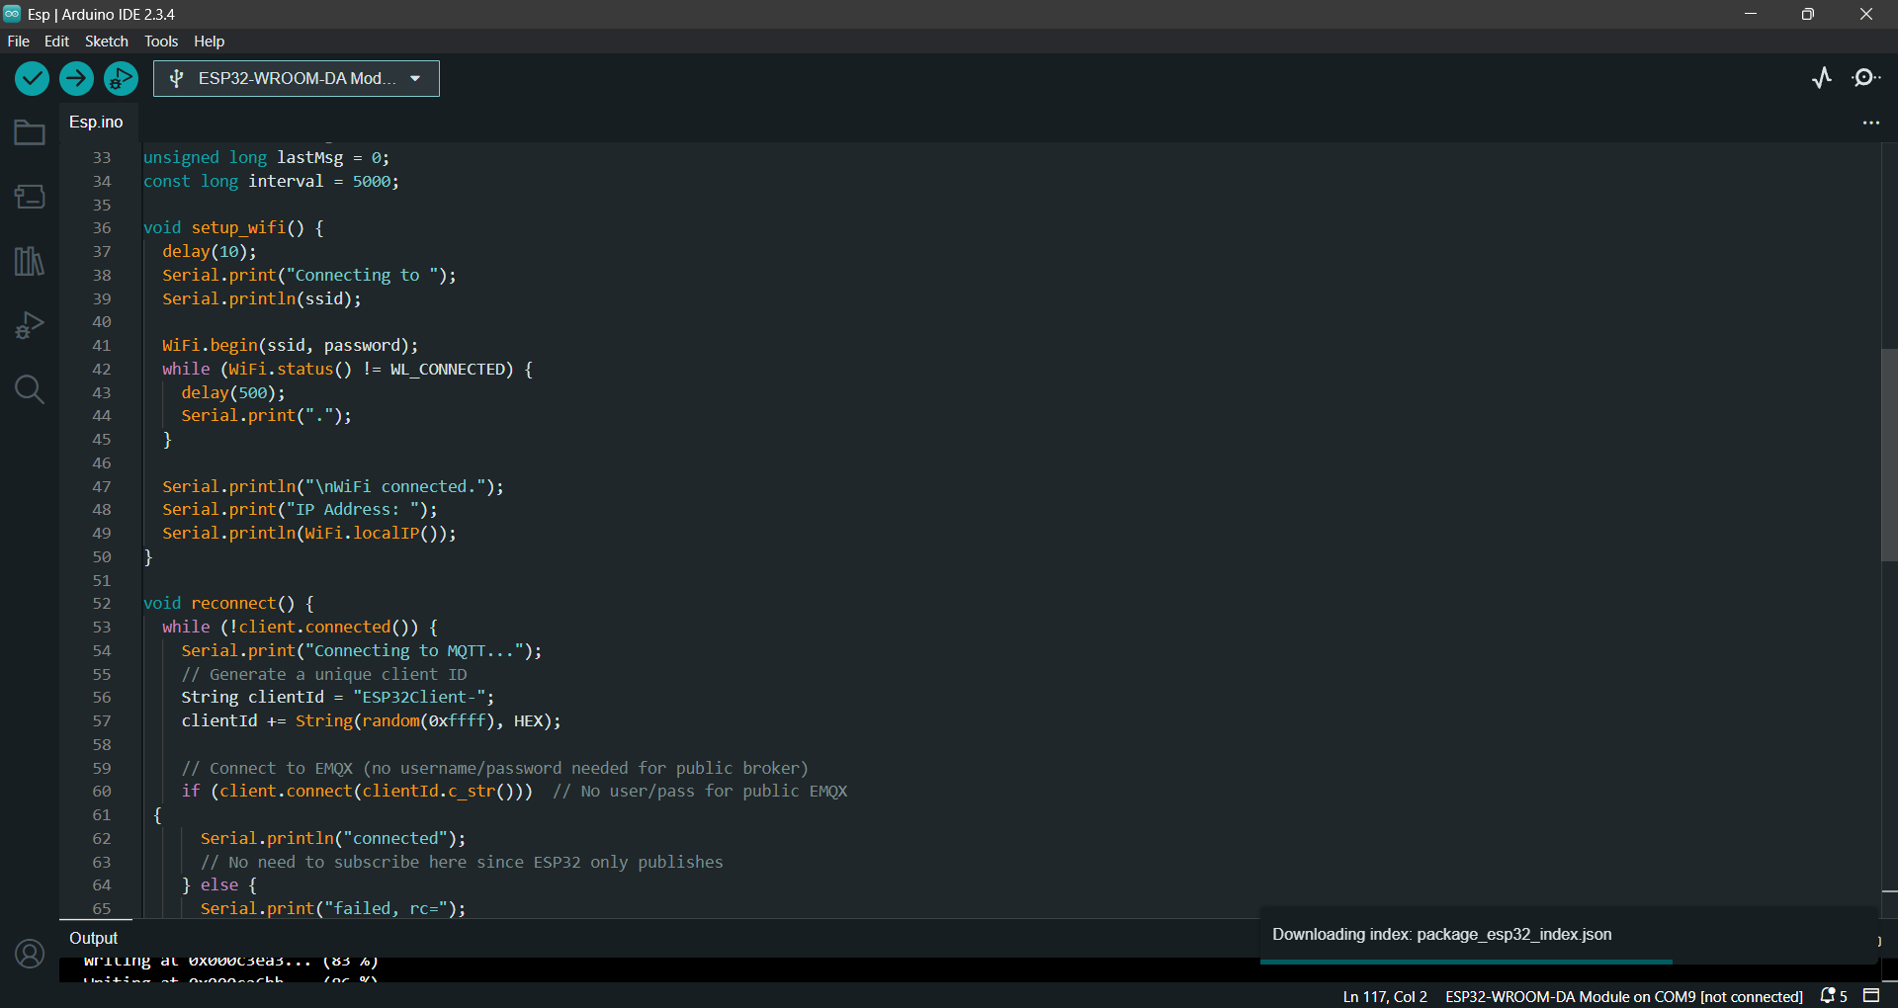

Slide 19
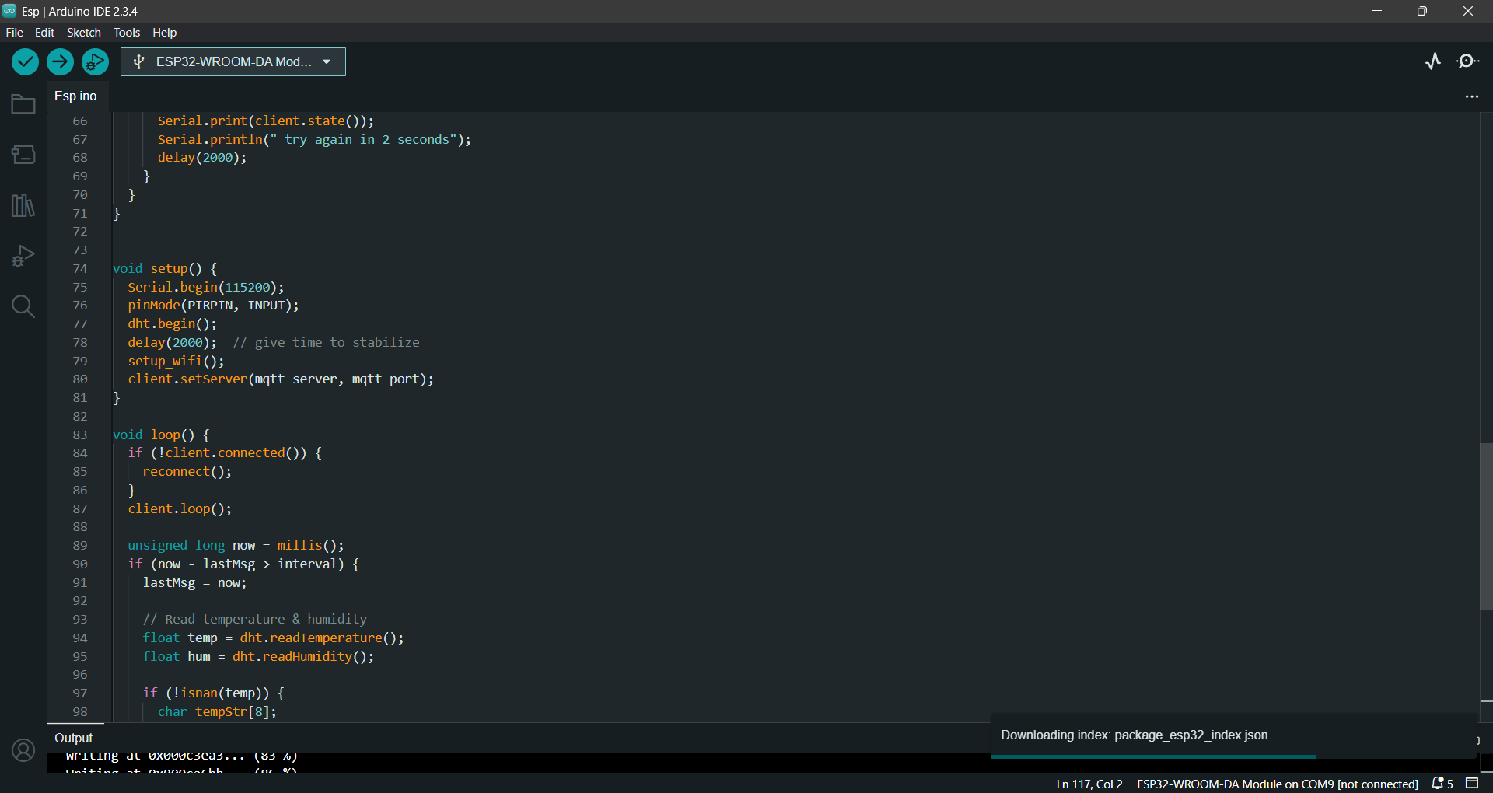

Slide 20
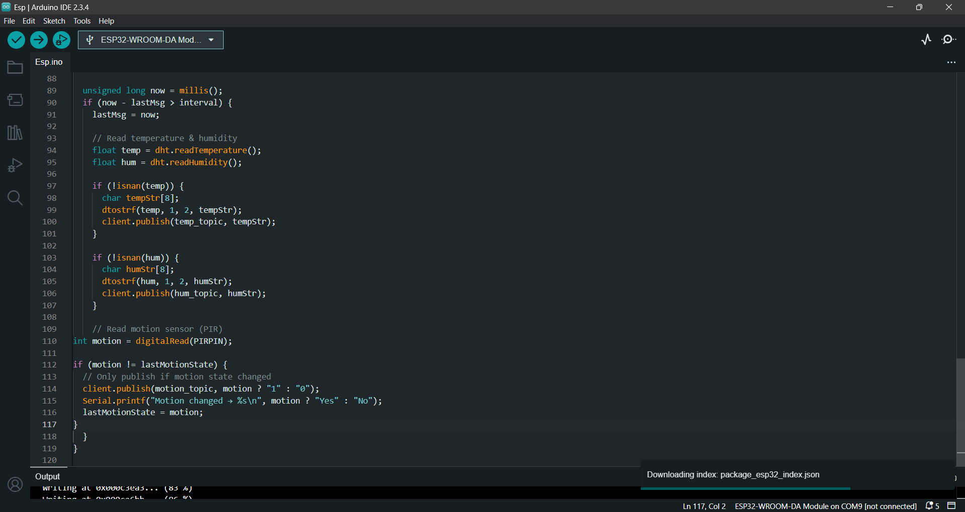

Slide 21
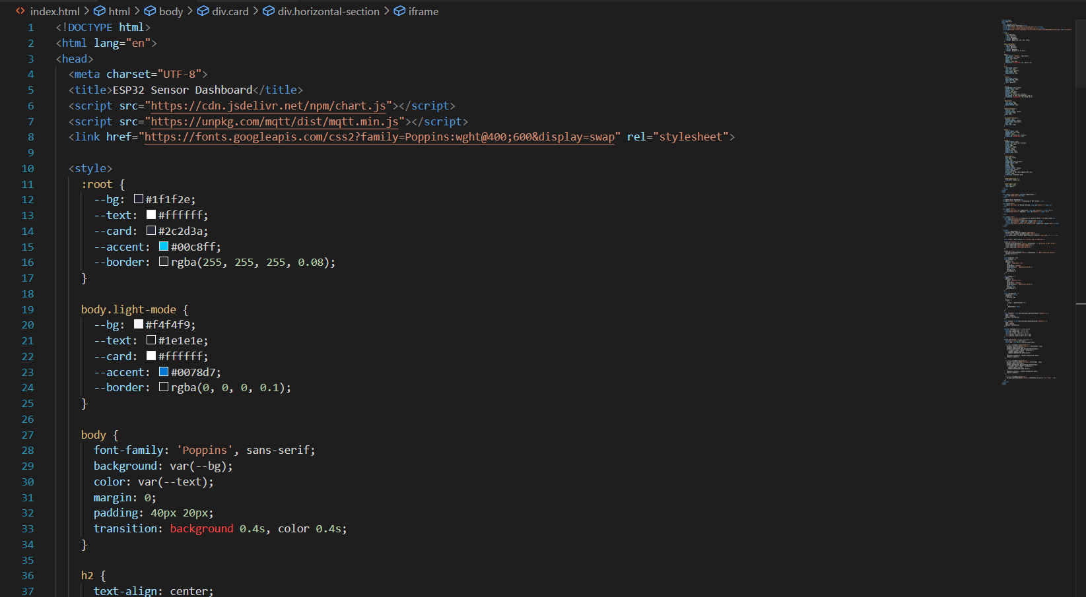

Slide 22
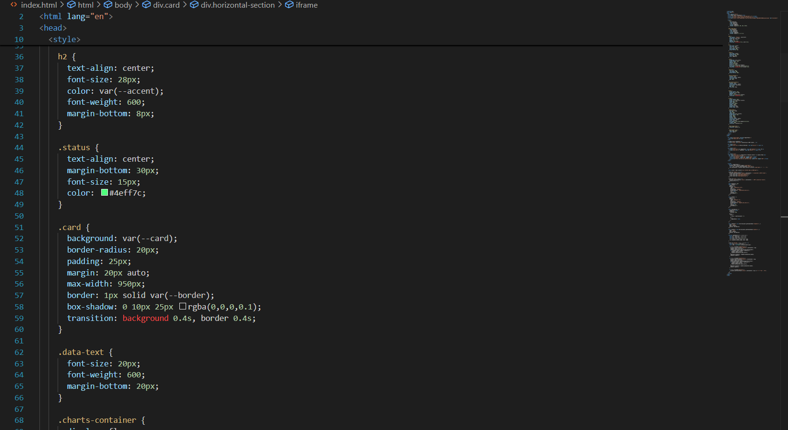

Slide 23
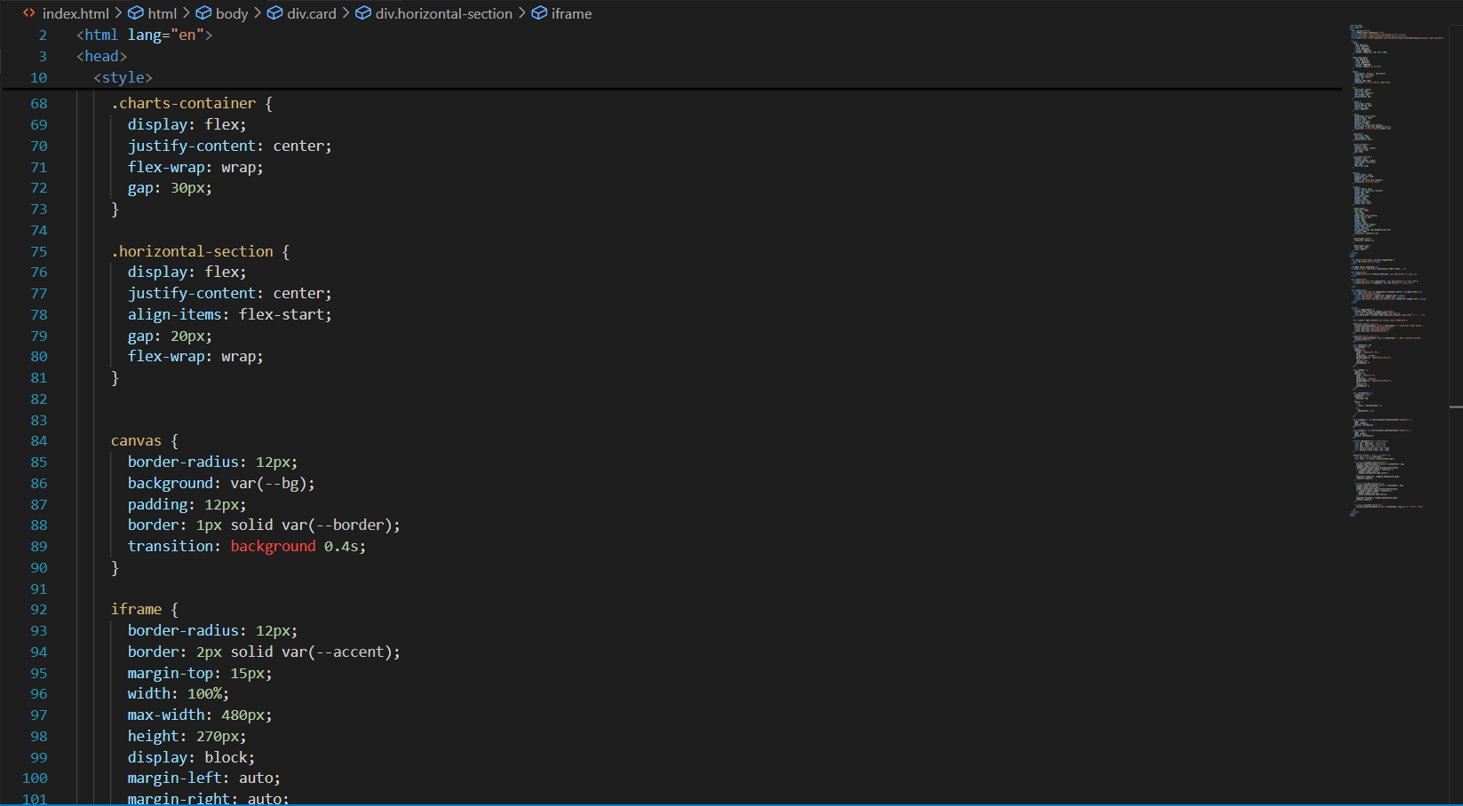

Slide 24
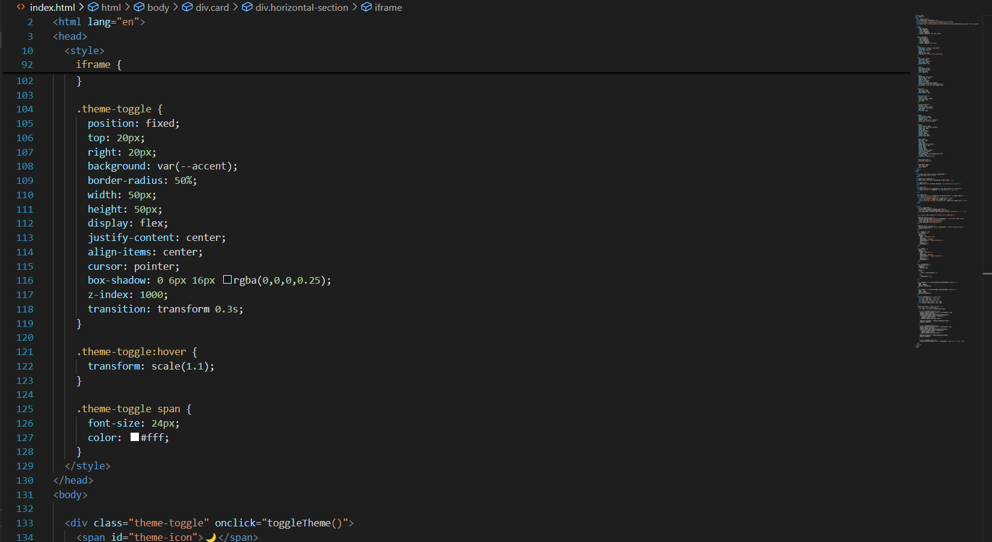

Slide 25
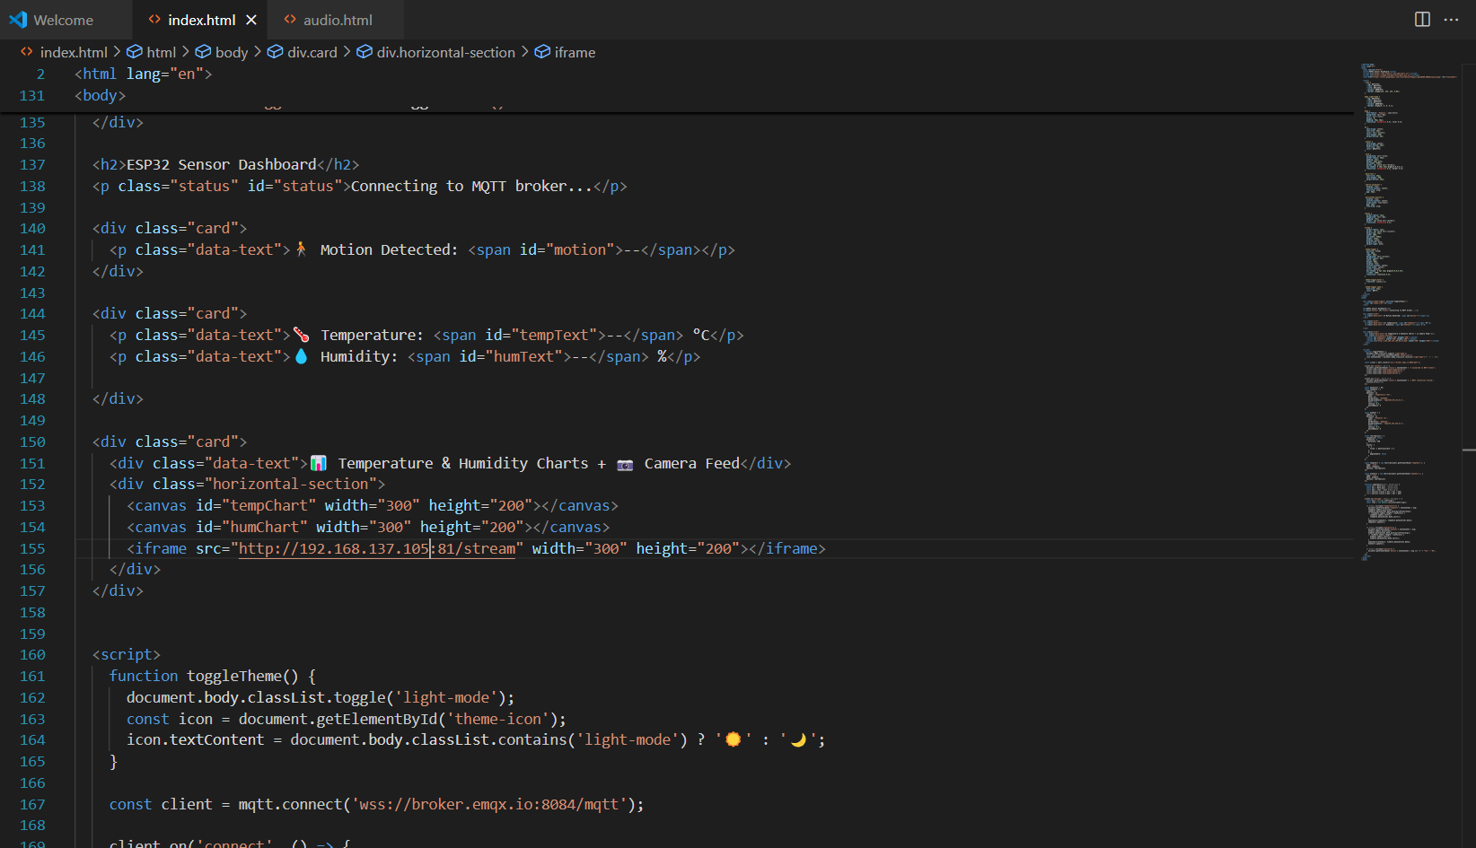

Slide 26
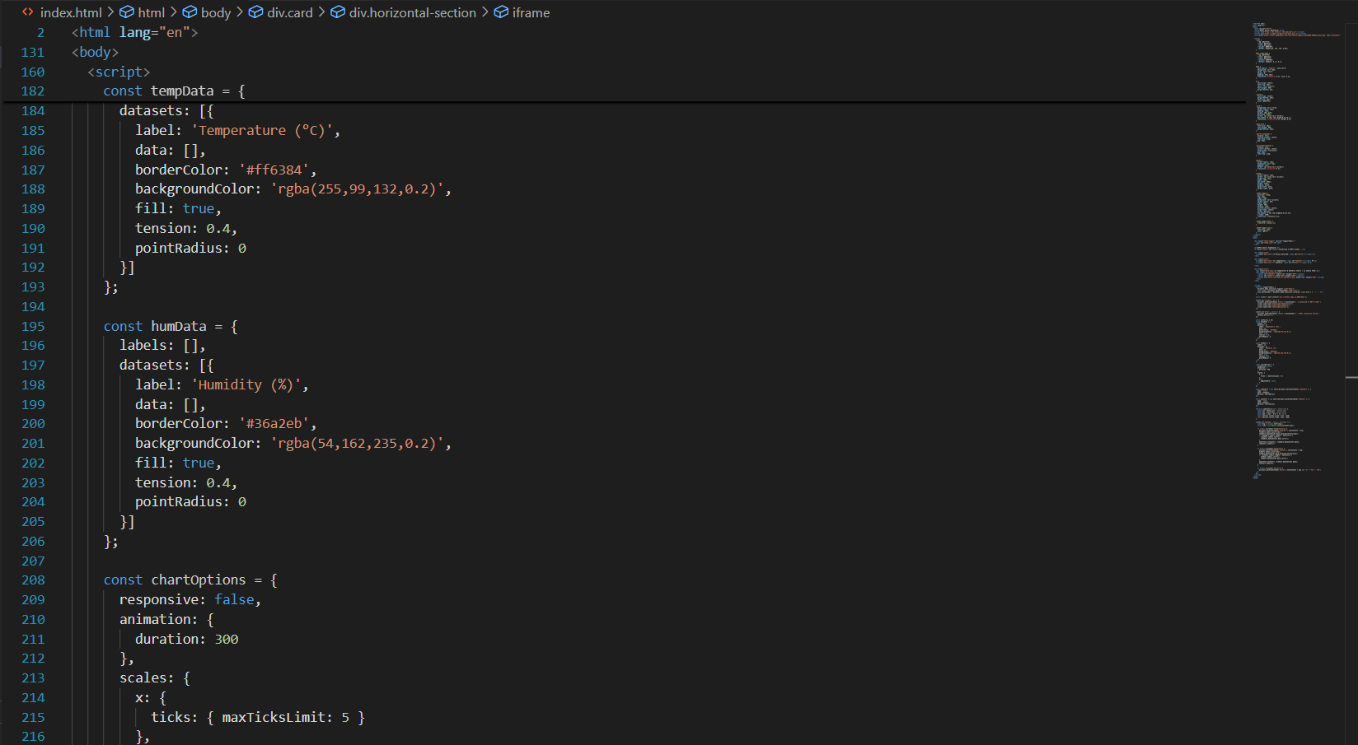

Slide 27
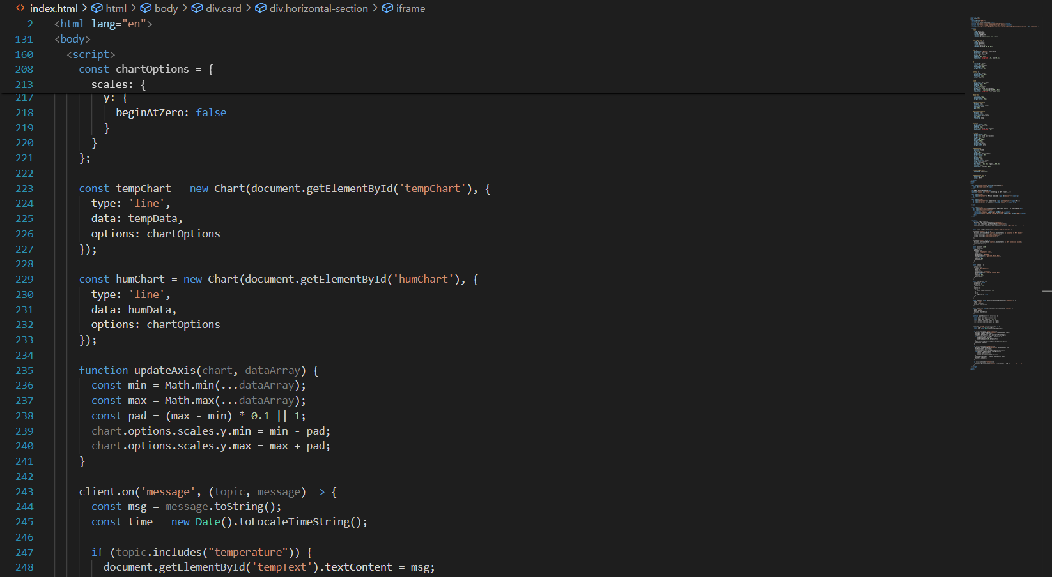

Slide 28
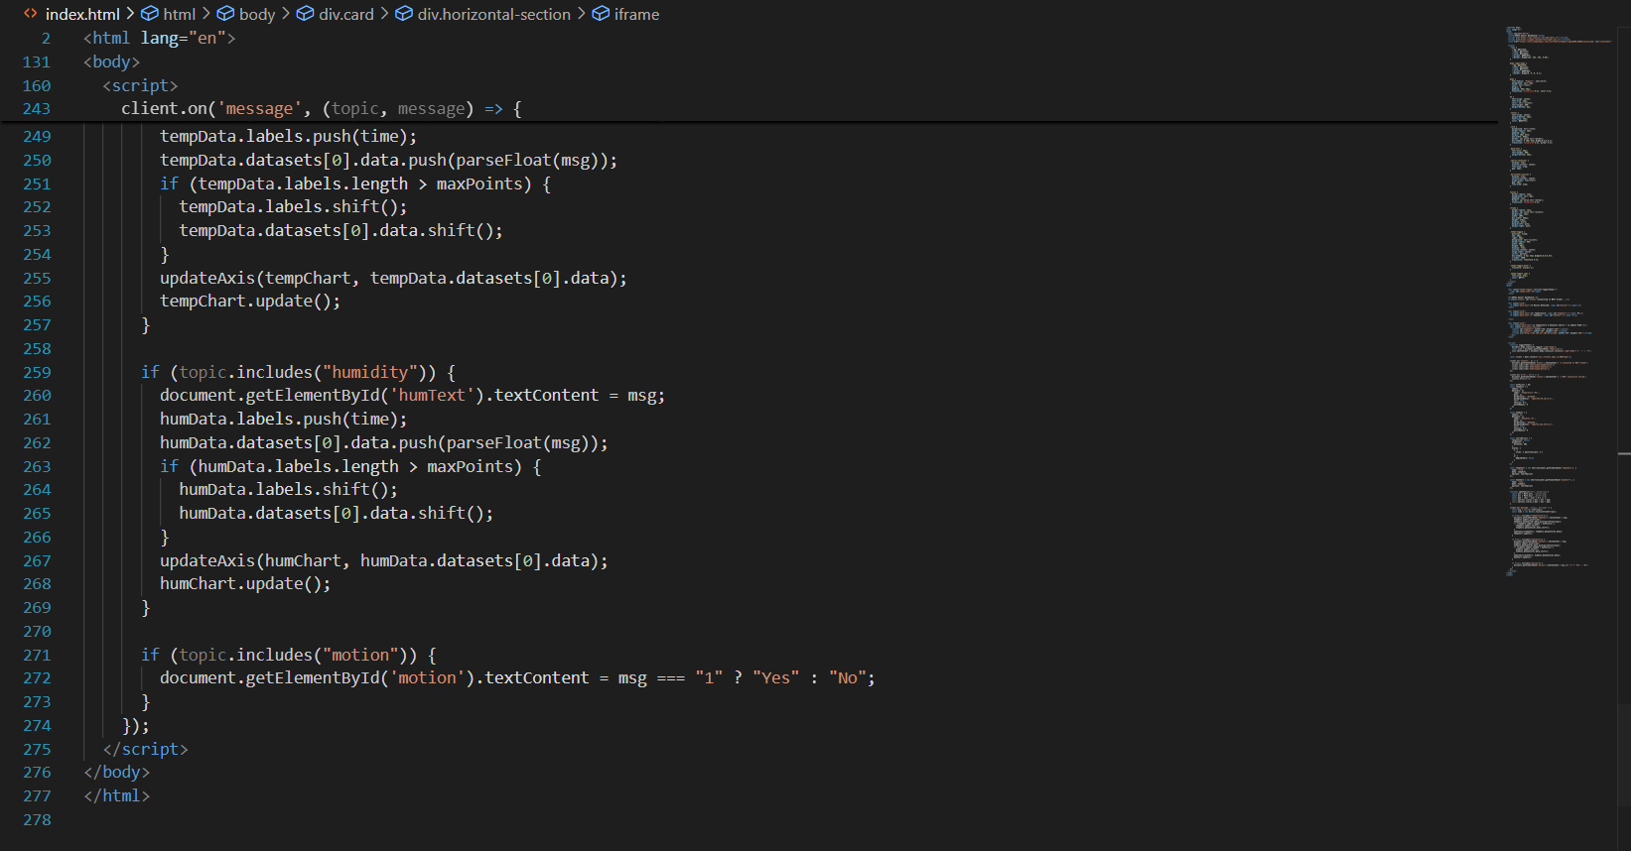

Slide 29
Results

Slide 30
Web App Dashboard

Slide 31
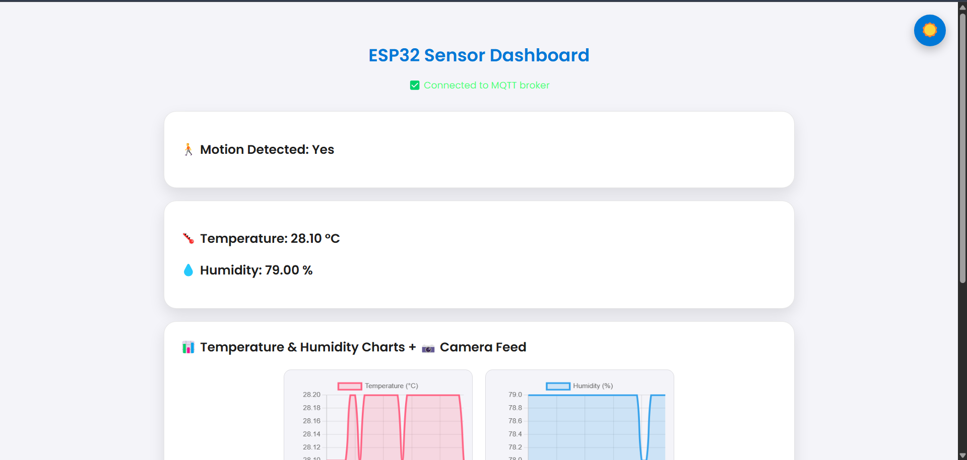

Slide 32
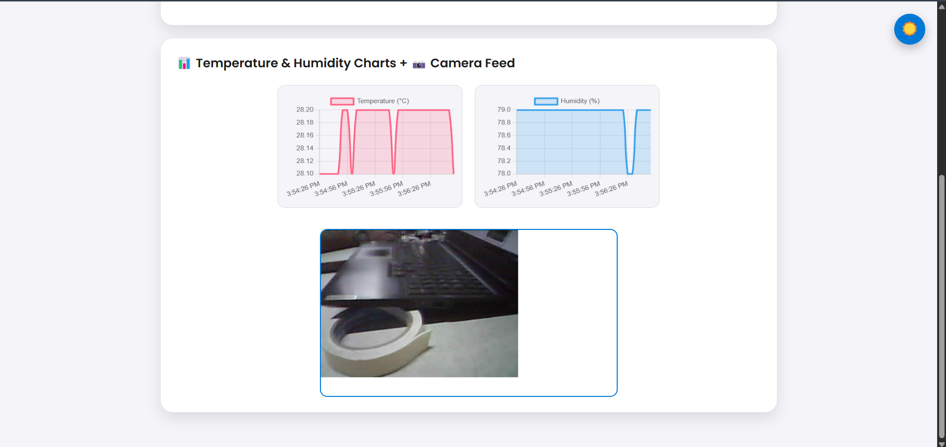

Slide 33
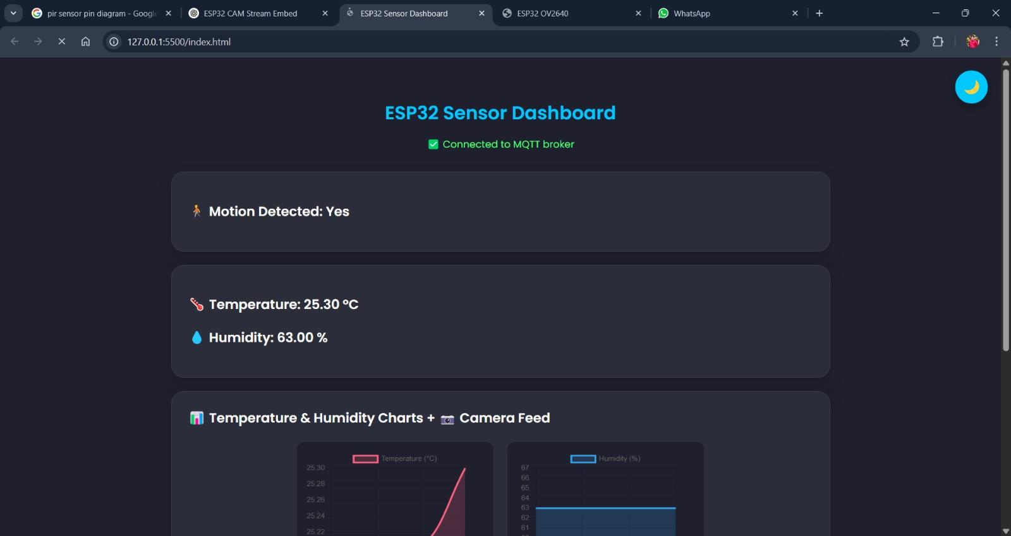

Slide 34
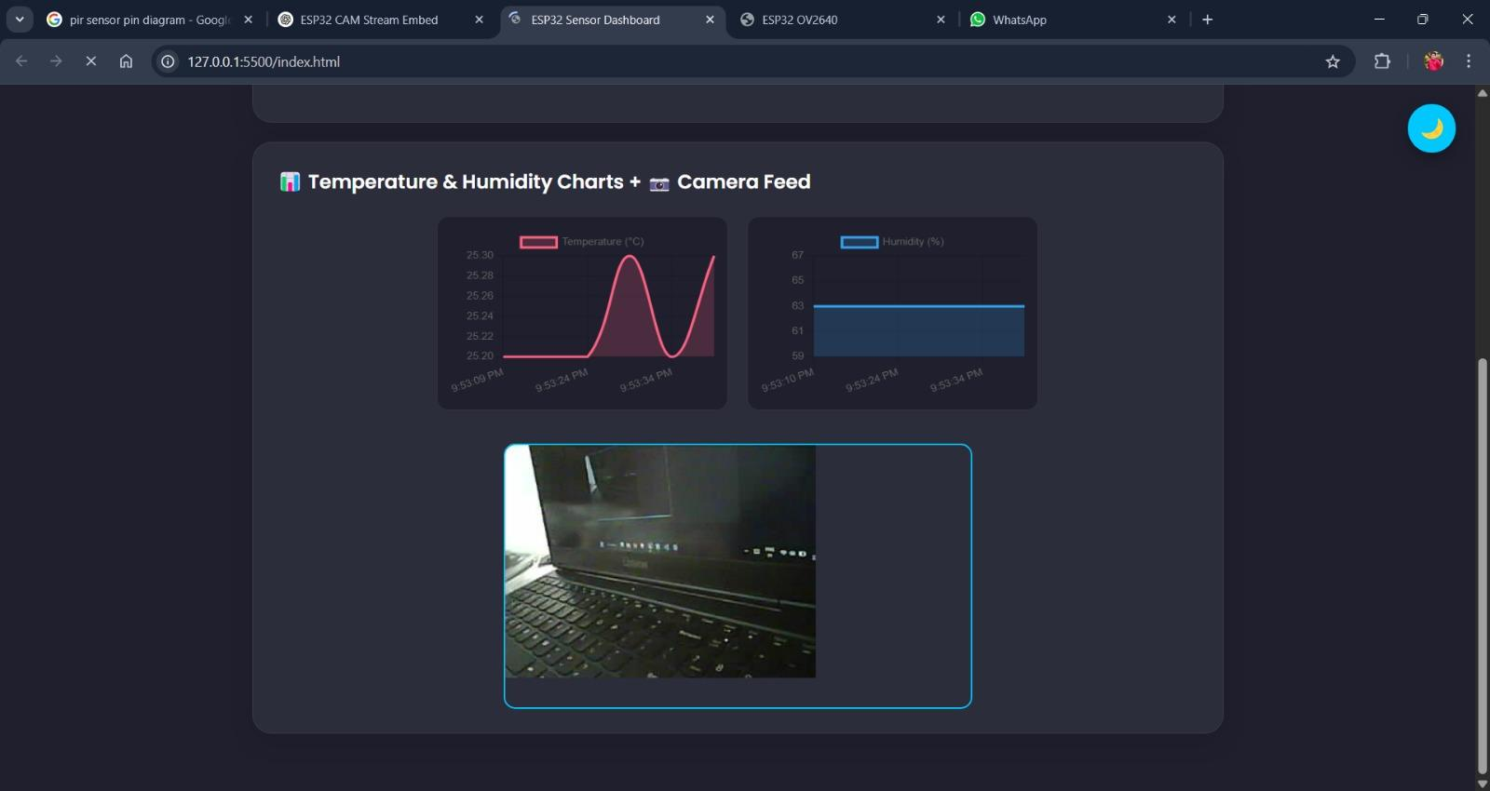

Slide 35
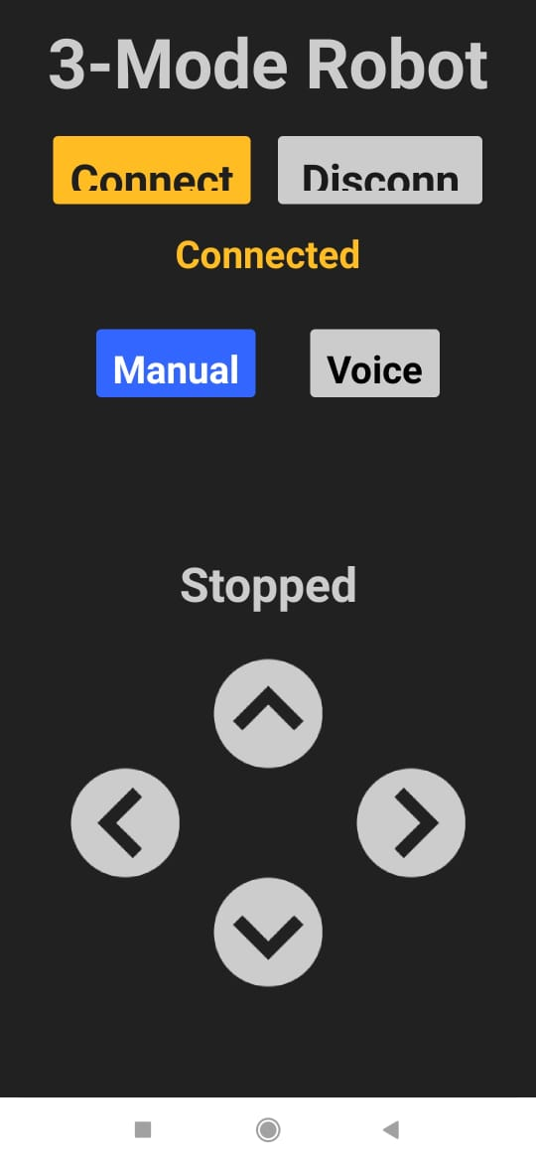
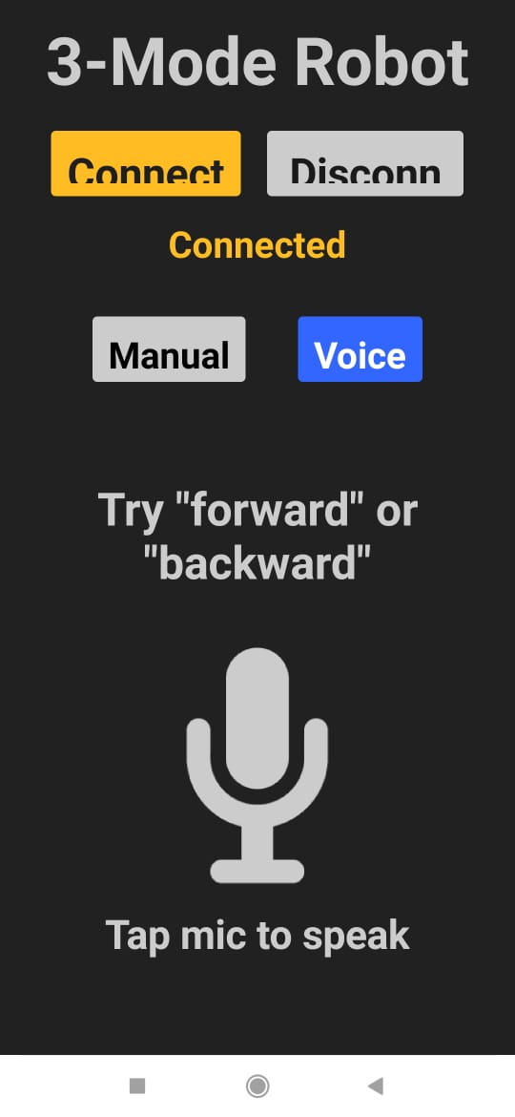
Screenshots of app for
Manual (left)
&
Voice control (Right)

Slide 36
THANK YOU!

